Slide 1

WEEK - 3 ASSIGNMENT
NETWORK SECURITY
Name : B SAI AMULYA GOUD
SIN : DG/SEPTEMBER/CYBER/179

Slide 2
OBJECTIVE
  To perform network discovery using Nmap and identify active hosts within the lab network.
  To identify open ports and services running on the Windows 7 test VM using Nmap scanning techniques.
  To capture and analyze network traffic using Wireshark and study protocols such as DNS, TCP, UDP, ARP, and ICMP.
  To correlate Nmap results with Wireshark traffic and understand how network scanning generates TCP packets such as SYN, SYN/ACK, and RST.
  Apply at least three concrete hardening measures and verify the resulting reduction in attack surface.
  • Produce a professional, evidence-backed security assessment and a set of actionable recommendations.
Vulnerability Assessment

Slide 3
Lab Architecture
Component | Configuration | Purpose
Kali Linux VM | 10.0.2.4 | Security testing and scanning
Windows 7 VM | 10.0.2.3 | Authorized target system
VirtualBox NAT Gateway | 10.0.2.1 | Network connectivity
Lab Network | 10.0.2.0/24 | Connects the virtual machines
Wireshark | Kali Linux | Network traffic capture and analysis
Nmap | Kali Linux | Network and vulnerability assessment
Windows Firewall | Windows 7 | Security hardening

Slide 4
Tools used
Tool | Purpose
Kali Linux | Security testing and assessment environment
Windows 7 VM | Authorized target/test system
VirtualBox | Created and managed the virtual lab environment
Nmap | Host discovery, port scanning, service/version detection, OS detection and vulnerability assessment
Wireshark | Network traffic capture and packet analysis
Windows Firewall | Applied security hardening and restricted inbound ports
diagrams.net (draw.io) | Created the network topology diagram

Slide 5
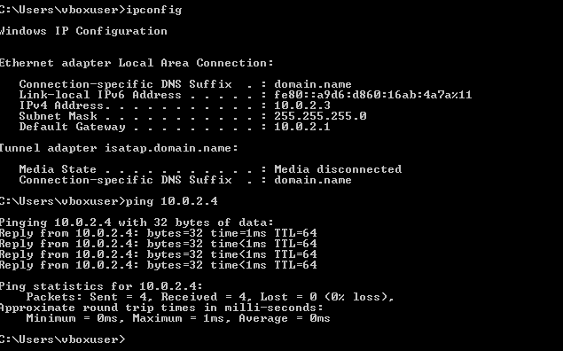
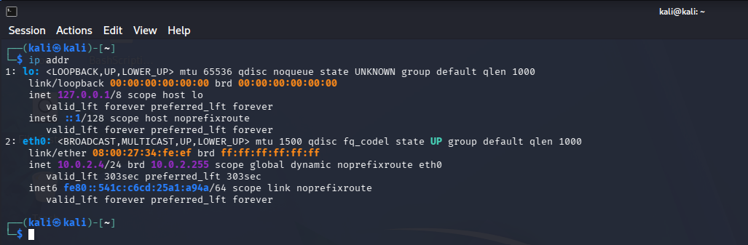
TASK - 7
Network Discovery&Basic
Nmap
Network discovery is the process of identifying active devices within a network. It helps a security professional understand which hosts are reachable and which systems may need further security assessment

Slide 6
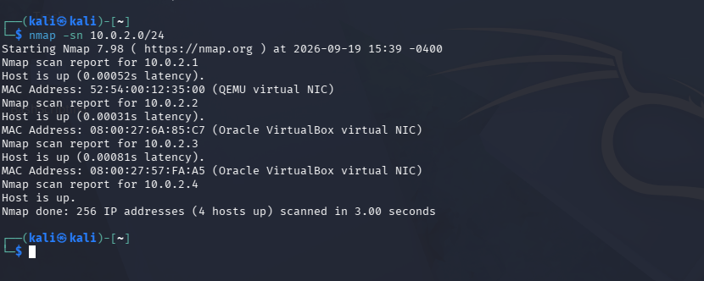
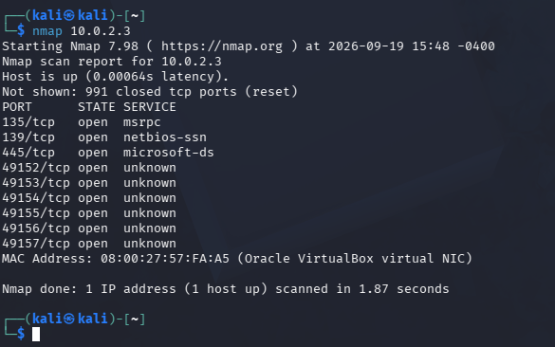

Slide 7
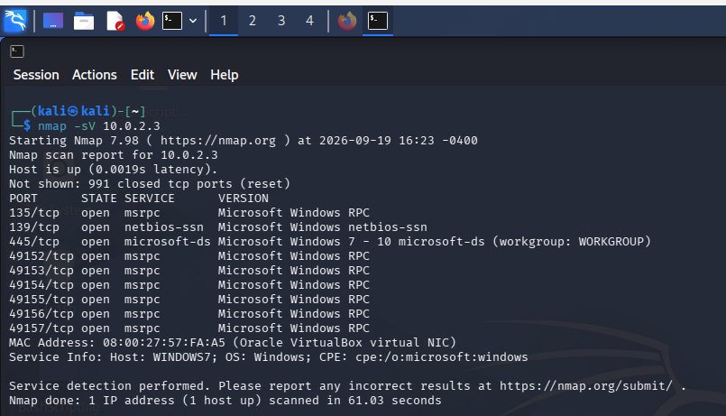
task - 8 Advanced Nmap Security Assessment
Service and Version Detection : nmap -sV 10.0.2.3 The -sV option attempts to determine the service and version associated with open ports.

Slide 8
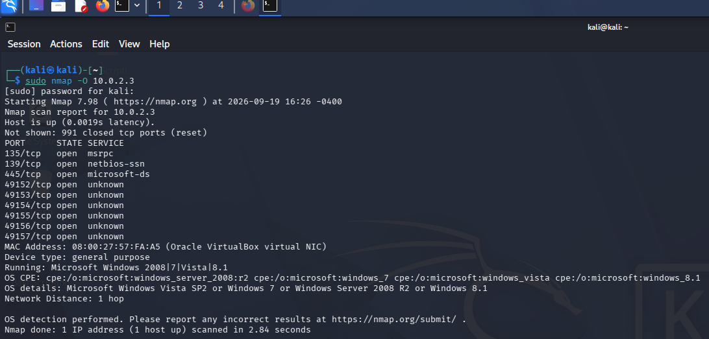
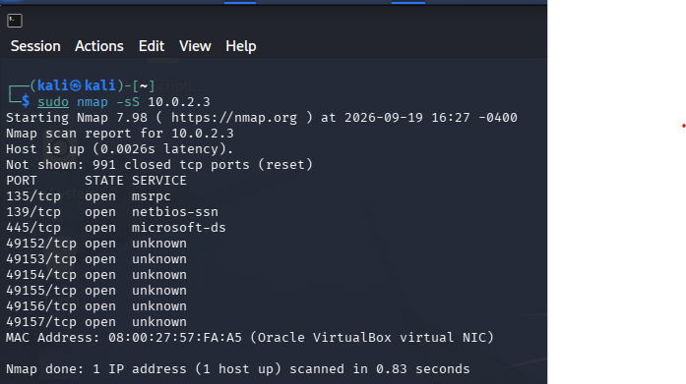
OPERATING SYSTEM DETECTION :->
88%
52%
<-: TCP SYN SCAN

Slide 9
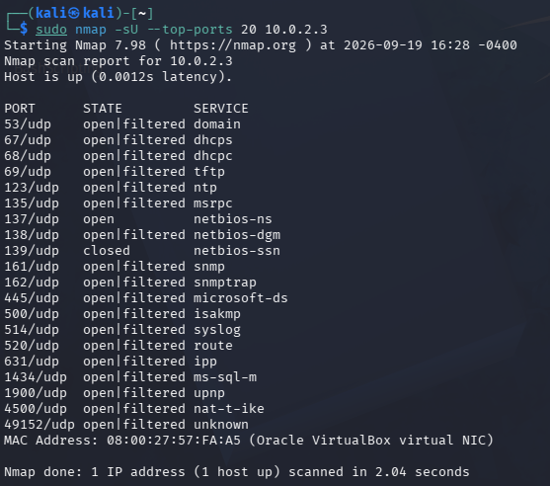
UDP SCAN :->

Slide 10
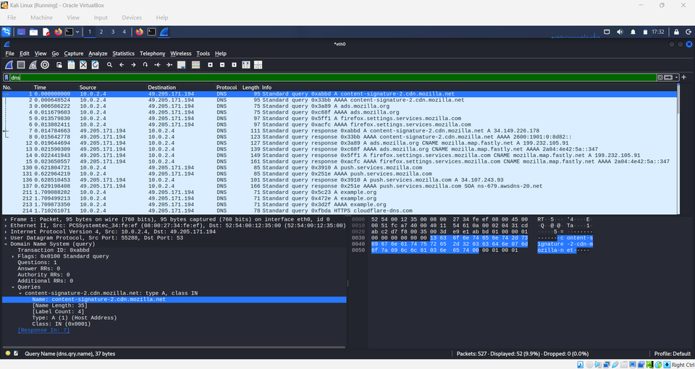
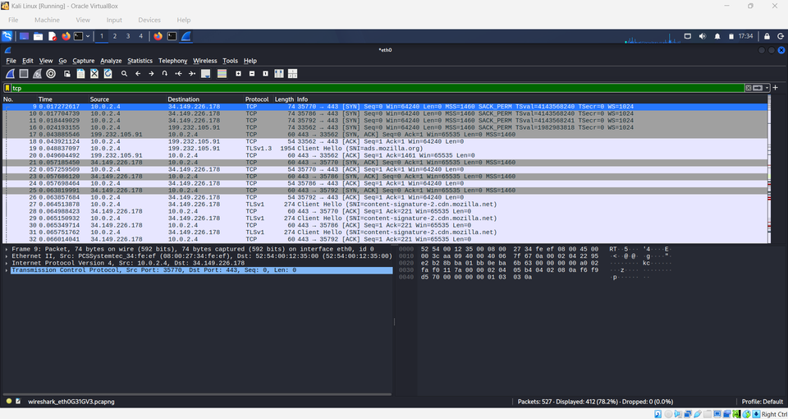
task -9 Wireshark Network Traffic Capture
DNS :->
<-: TCP

Slide 11
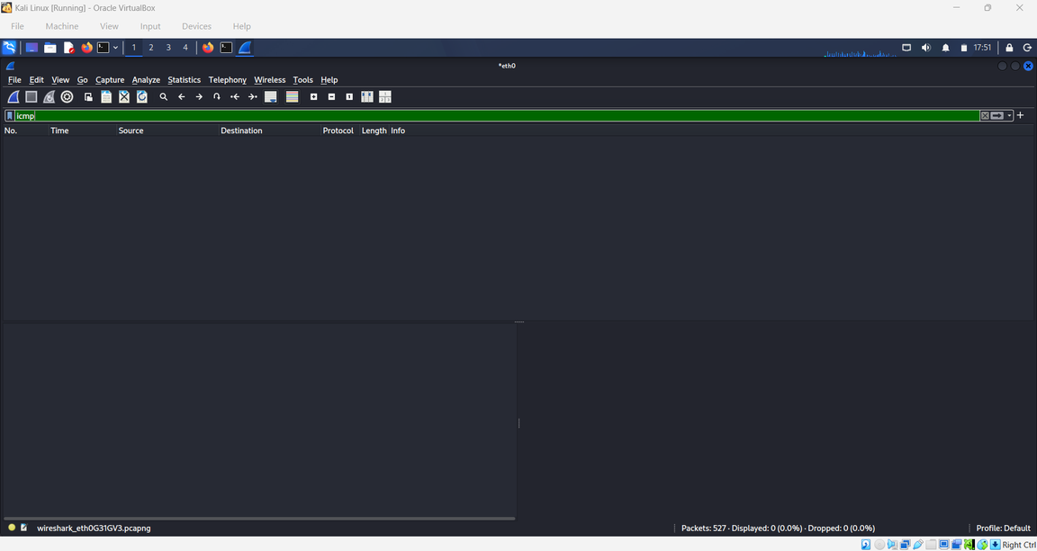
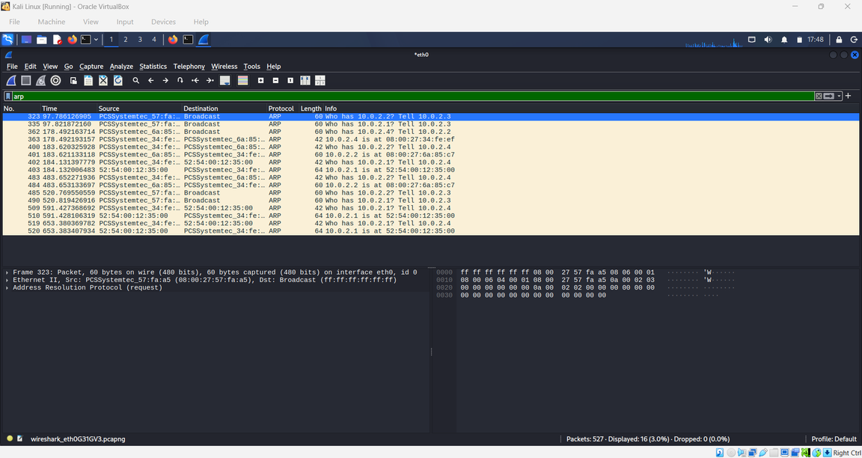
<-: icmp
ARP :->

Slide 12
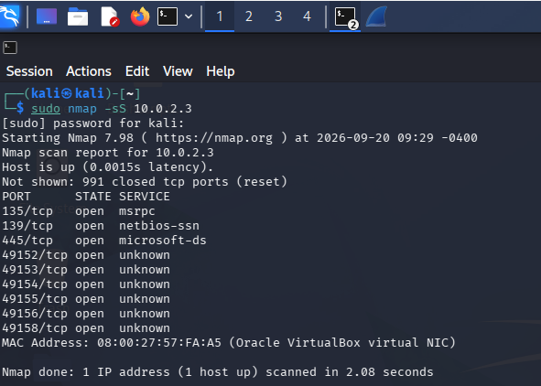
TASK - 10 Nmap + Wireshark Investigation
This screenshot shows a Kali Linux terminal window executing an Nmap TCP SYN stealth scan against target IP address 10.0.2.3. The command sudo nmap -sS 10.0.2.3 was issued, leveraging root privileges to craft raw SYN packets and evaluate target port states without establishing full TCP connections.

Slide 13
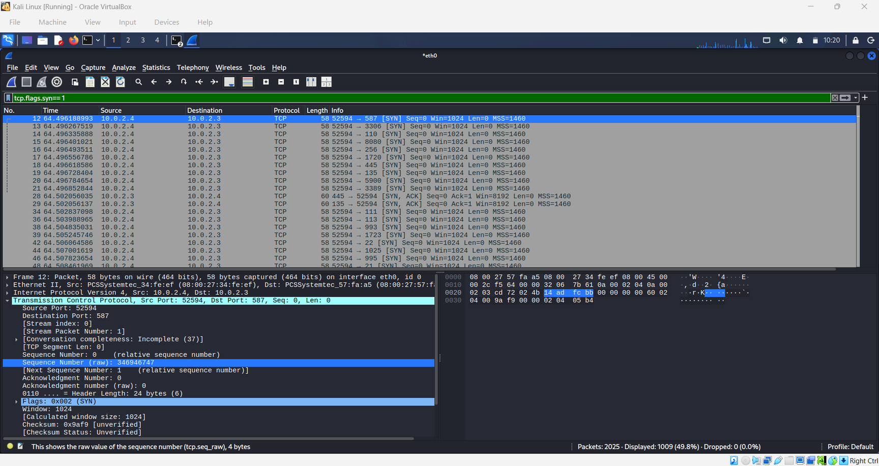
TCP SYN : This screenshot shows Wireshark running on Kali Linux with the display filter set to tcp.flags.syn == 1. This filter isolates all TCP synchronization packets, capturing initial connection attempts across the eth0 network interface.

Slide 14
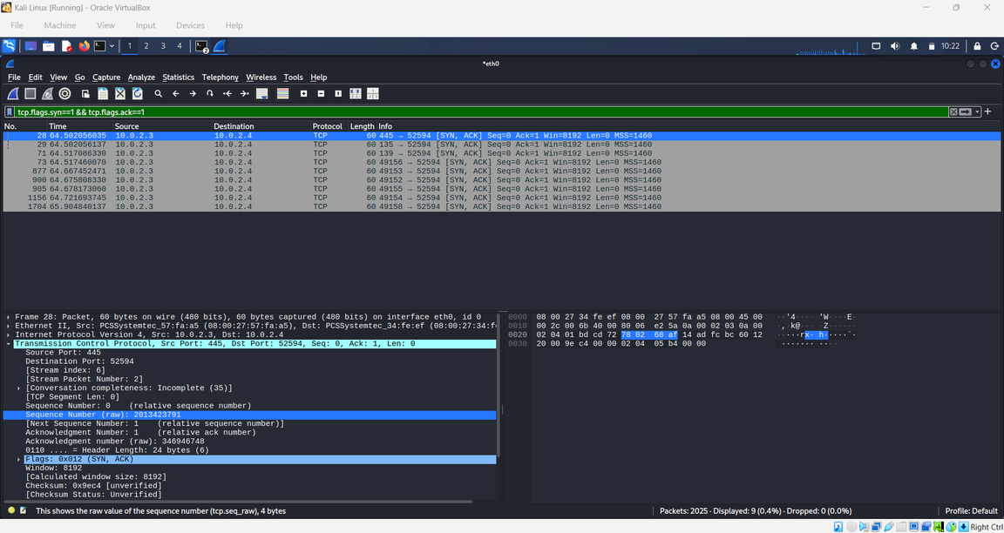
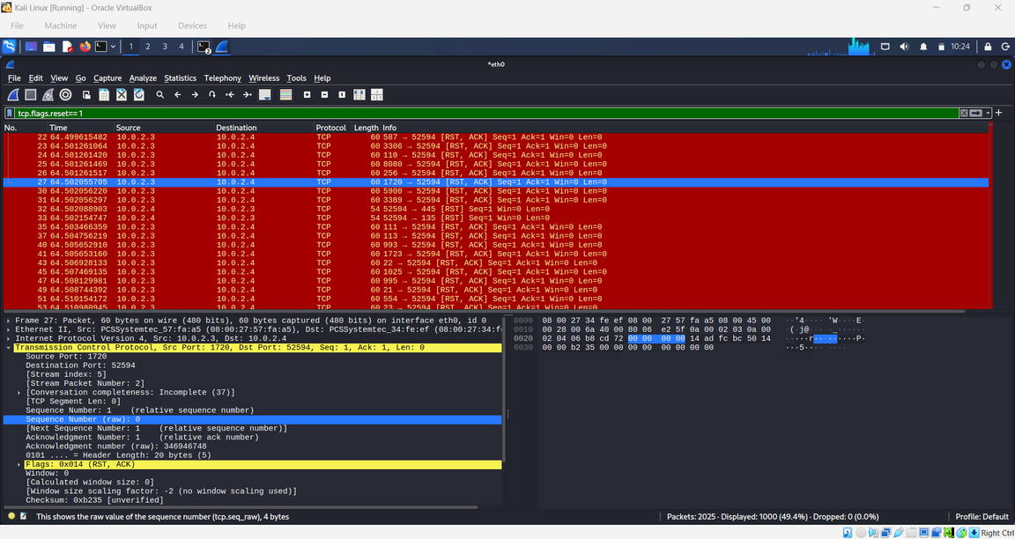
Continuous Zero-Trust Security

Slide 15
Task 11 – Advanced Network Traffic Investigation
No. | Traffic/Event | Wireshark Filter | Observation | Interpretation
1 | DNS queries | dns | DNS queries and responses were observed between Kali and the DNS server. | Normal name-resolution activity was observed.
2 | TCP traffic | tcp | TCP packets including connection establishment traffic were captured. | Indicates normal TCP communication in the lab.
3 | TCP SYN packets | tcp.flags.syn == 1 | SYN packets were generated during Nmap scanning. | Represents attempts to establish TCP connections with the target.
4 | TCP RST packets | tcp.flags.reset == 1 | RST/ACK packets were observed from the Windows 7 VM. | Indicates that some TCP connection attempts were rejected or reset.
5 | ICMP traffic | icmp | ICMP Echo Request/Reply packets were observed during connectivity testing. | Confirms communication between the Kali and Windows 7 VMs.
6 | ARP traffic | arp | ARP packets were observed for IP-to-MAC address resolution. | Normal local network address-resolution activity.

Slide 16
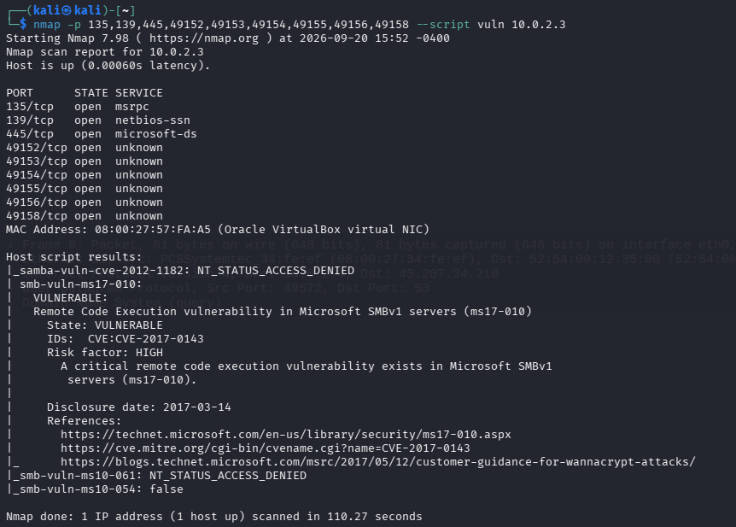
TASK -12 Vulnerability Assessment

Slide 17
Findings | Evidence | Risk | Potential Impact | Recommendation
MS17-010 / SMBv1 vulnerability | NSE smb-vuln-ms17-010, CVE-2017-0143 | High | Potential remote code execution | Apply appropriate Windows security updates and disable SMBv1 if not required
SMB/Microsoft-DS exposed | 445/tcp open microsoft-ds | Medium | Increased SMB attack surface | Restrict access to trusted systems
NetBIOS-SSN exposed | 139/tcp open netbios-ssn | Medium | Legacy service exposure | Disable/restrict if unnecessary
MSRPC exposed | 135/tcp open msrpc | Medium | Increased RPC attack surface | Restrict RPC access
Multiple RPC ports exposed | 49152–49158/tcp open | Medium | Additional exposed services | Restrict unnecessary RPC traffic

Slide 18
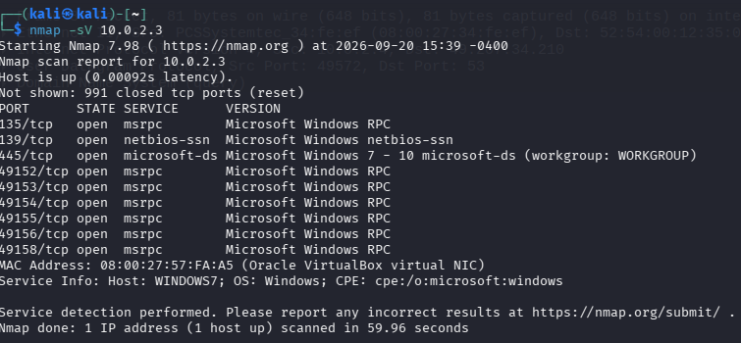
TASK - 13 Security Hardening & Before/After Testing
BEFORE HARDENING :->

Slide 19
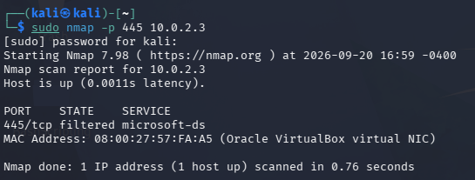
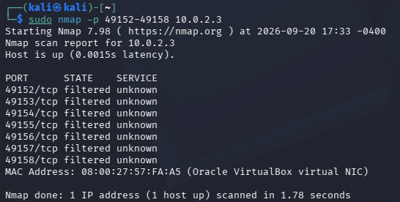
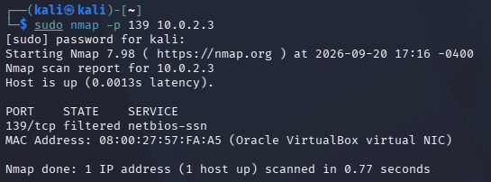
AFTER HARDENING :->

Slide 20
TASK - 14 Final Mini Security Assessment
  The objective of the final assessment was to evaluate the security posture of the authorized Windows 7 test VM after network discovery, service enumeration, traffic analysis, vulnerability assessment, and security hardening.
  BEFORE vs AFTER :
Port | Before Hardening | After Hardening
445/TCP | Open | Filtered
139/TCP | Open | Filtered
49152–49158/TCP | Open | Filtered

Slide 21
  FINDINGS :
The assessment identified exposed SMB, NetBIOS and dynamic RPC services on the Windows 7 test VM. Nmap vulnerability scanning also reported a potential MS17-010-related SMB vulnerability. Wireshark was used to analyze authorized lab traffic, including DNS and TCP traffic.
  FINAL RECOMENDATIONS :
  Keep Windows Firewall enabled.
  Restrict unnecessary inbound ports.
  Reduce unnecessary SMB and NetBIOS exposure.
  Keep the operating system updated.
  Monitor network traffic for unusual activity.
  Perform regular authorized security assessments.

Slide 22
CONCLUSION :
This Week 3 assessment carried a full offensive-to-defensive workflow: identifying the target, enumerating services with Nmap, validating behavior at the packet level with Wireshark, correlating scan traffic to captured packets, and translating findings into concrete hardening actions.
Overall, the assessment strengthened practical skills across reconnaissance, traffic analysis, and defensive hardening within a safe, authorized lab environment.
REFERENCES :
▪ Nmap Reference Guide — https://nmap.org/book/man.html
▪ Nmap Scripting Engine (NSE) Documentation — https://nmap.org/book/nse.html
▪ Wireshark User's Guide — https://www.wireshark.org/docs/wsug_html_chunked/
▪ CVE Program — https://cve.mitre.org
▪ MITRE ATT&CK — https://attack.mitre.org
▪ Microsoft netsh advfirewall Command Reference

Slide 23
THANK YOU

